Slide 1

Emanate Wireless – Investor Pitch
“Smarter healthcare, powered by wireless innovation & AI”
June 30, 2025

Slide 2




Emanate Wireless – Company Overview
COMPANY PROFILE
5 Issued Patents
Product in Field
1200 Active Temp Monitors, $100K recurring
Cleveland Clinic is main customer
Disruptive New Product
Ready to go into production
5K unit, $1M First OEM Order, $100K recurring
Company Founded 2014
Delaware C-Corp
“Disruptive Technologies for Healthcare based on Wireless Innovations”
$2M Angel Raised
Product Development and Consulting
A UNIQUE AND EFFECTIVE TEAM
Four Co-Founders
25 Years as a “Band of Brothers”
2 PhD EE, 2 MSEE
Multiple Successful Startup Exits
Cellular (Motorola)
WiFi (Cisco)
Innovative
Multiple products sold in Quantity Millions
Industry Awards
60+ Joint Patents
Wireless Experts at Physical Layer
Rare Skill Set
Only found at Chipset Players and DoD

Slide 3
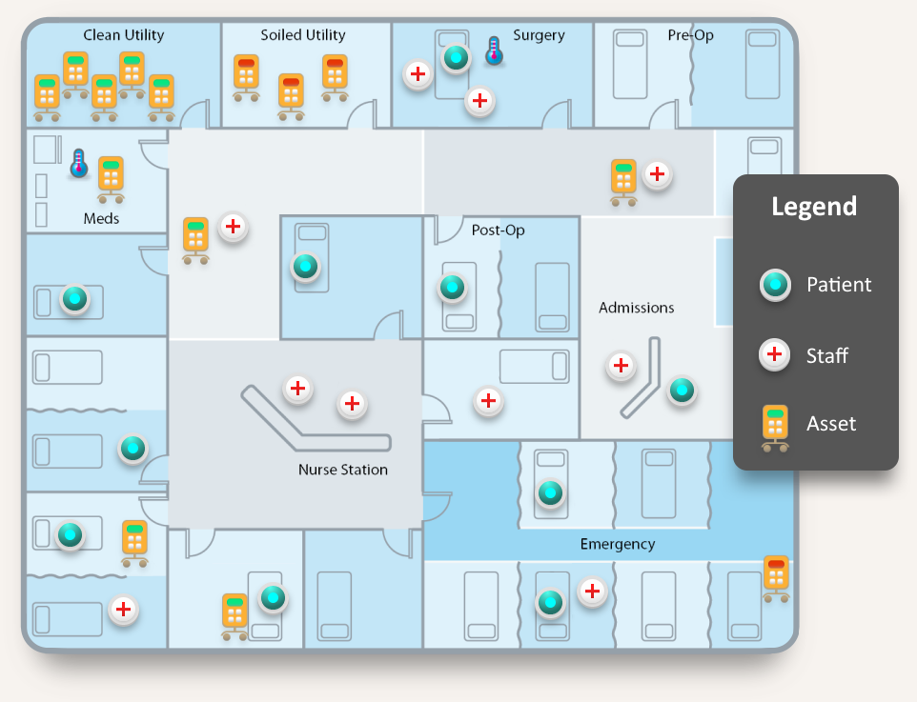
Key Hospital Market Need: Room-Accurate Location
Healthcare Costs Pushed to the Limit
As such, Hospitals must achieve better efficiency
Efficiency requires Scheduling and Analytics of all the “Moving Pieces”
Staff, Patients, Equipment
Room Accurate Location is Key, because the room provides Critical Context, for ex.:
Patient Room for Patient X
Operating Room for Procedure Y
Clean-device Storage room for Unit Z
Ex. Use Cases Requiring Room Accurate Location:
Automated Nurse Call Cancel
Patient Experience
Equipment PAR-level management
Hand Hygiene Compliance
Room-Accuracy Location Provides Critical Contextual Information
Page ▪ 3

Slide 4










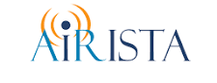
RTLS: $1B Existing Market in Need of DISRUPTION
Only Richest
Hospitals Can Afford
Old Guard
(Proprietary Tech)
HIGH
99.9%
RadioVision
Room
Accuracy
New Entrants
(BLE Based)
Cannot Fulfill
Key Use Cases
LOW
80%
HIGH
$1K+ room, $100 tag
Cost of
Ownership
LOW
$100 room, $5 tag
RTLS = Wireless Tracking Tags in Hospitals (People and Assets)
RTLS = WIRELESS TRACKING TAGS IN HOSPITALS
(PEOPLE AND ASSETS)

Slide 5
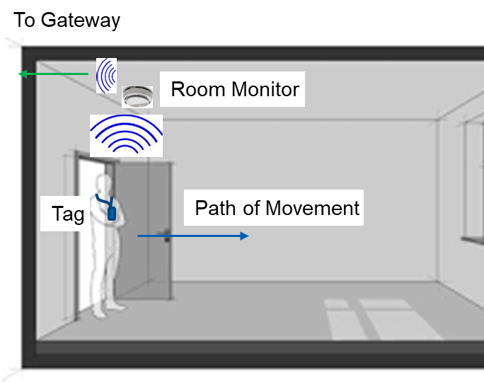
RadioVision: Innovative and Disruptive Approach
Battery Powered BLE Chokepoint
Detects Standard BLE Devices during Doorway Entry/Exit
Compatible with Tags, Cell Phones, Smart Watches, Medical Devices, ….
99.9+% Accurate Room-Level Location
Low Cost (CapEx and OpEx)
10X Better Solution Cost!
Commodity Standard BLE Tags
Standard BLE Infrastructure
Battery Powered – Lick’em and Stick’em
Utilizing the Latest Technologies
BLE 5.1 with Angle-of-Arrival!
Machine Learning!
Democratizes RTLS Across Full Spectrum of Hospitals!

Slide 6
ML-Based Technology
BLE 5.1 Antenna Array
provides phase
Info to Track
Path of User
Through Door
DSP Algorithms
Convert raw
Phase data into
Heatmap “Videos”
Machine Learning
“Video” Processing
Algorithm makes
Final determination
Of Exit/Entry event
Raw
Data
Algorithmic
Pre-Processing
Conditioned
Data
ML
Processing
Proprietary
Algorithms
Proprietary
Neural
Network
BLE
Antenna
Array
IQ
Heatmap
Data
RSSI
PIR
Scalar
Params
ML - Makes the Leap from 90% Accuracy to 99+% Accuracy!

Slide 7
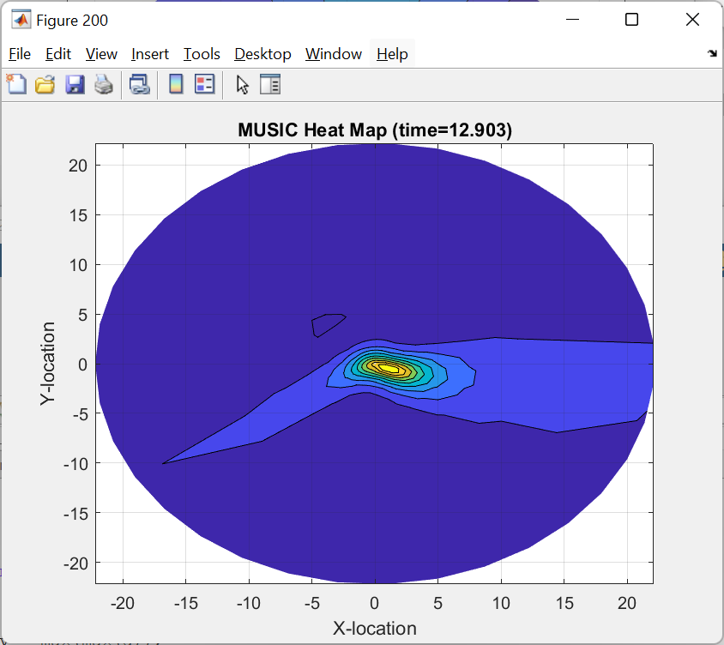
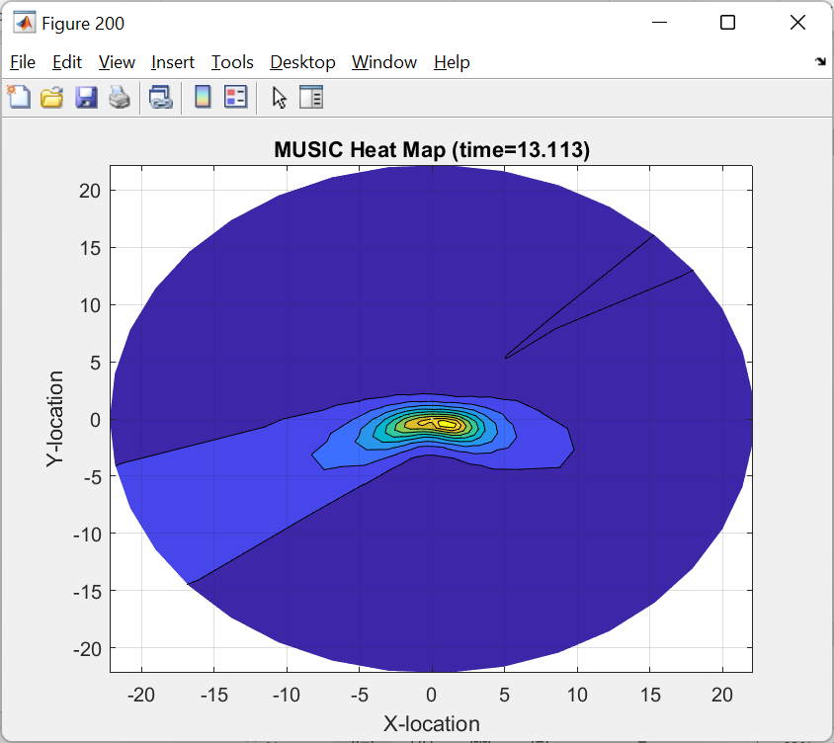
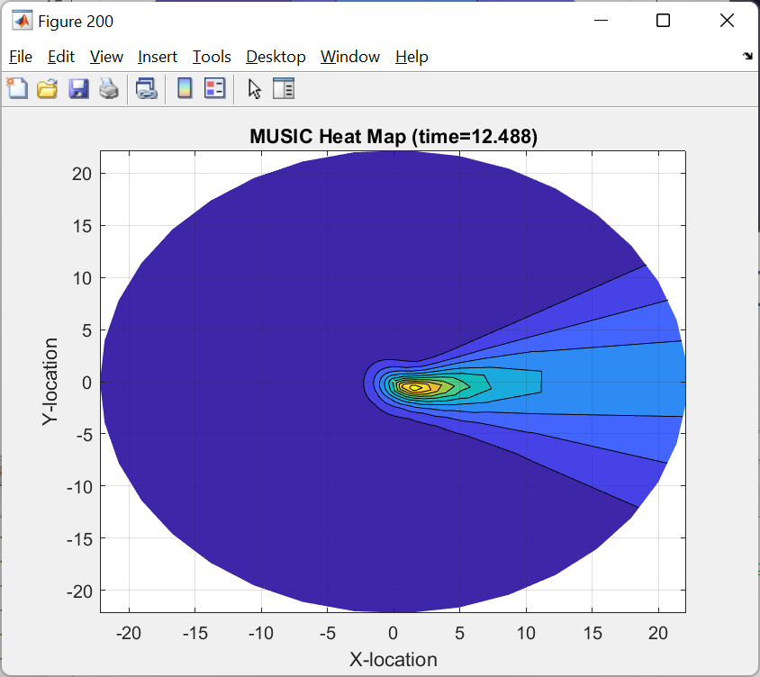
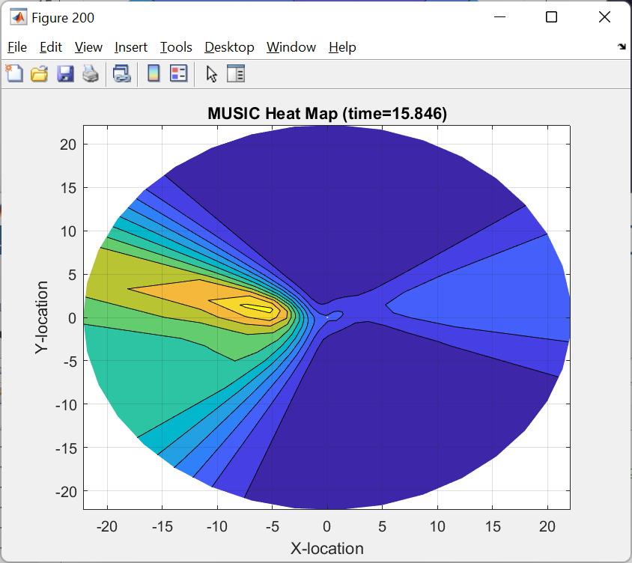
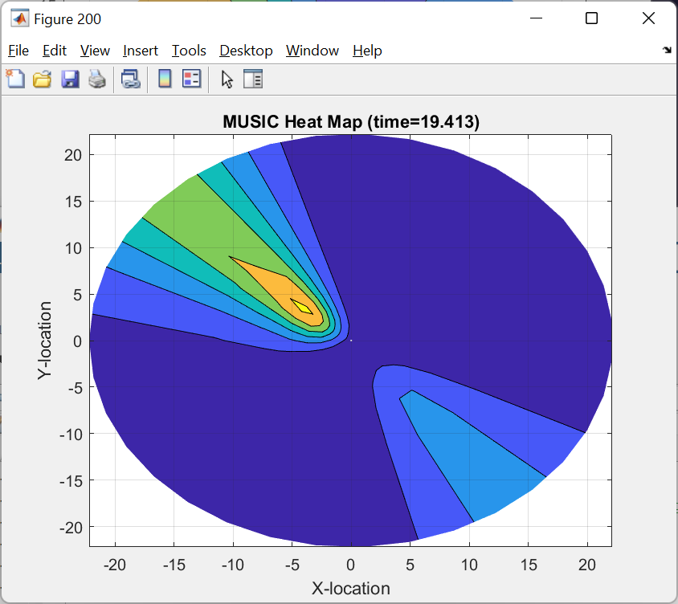
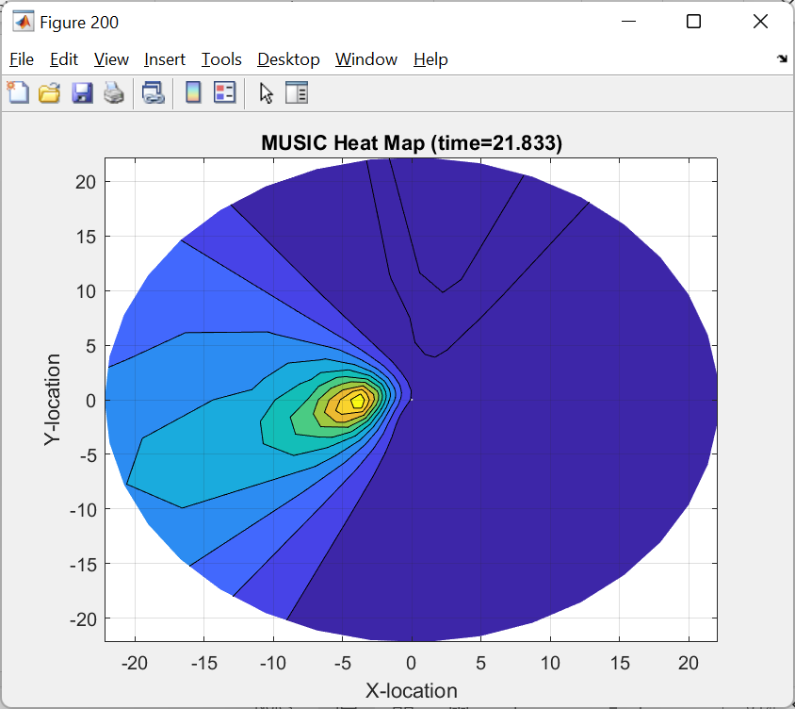
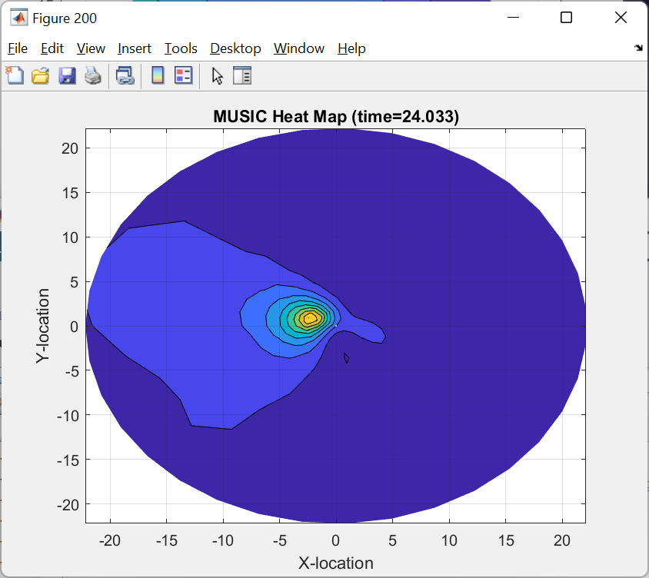
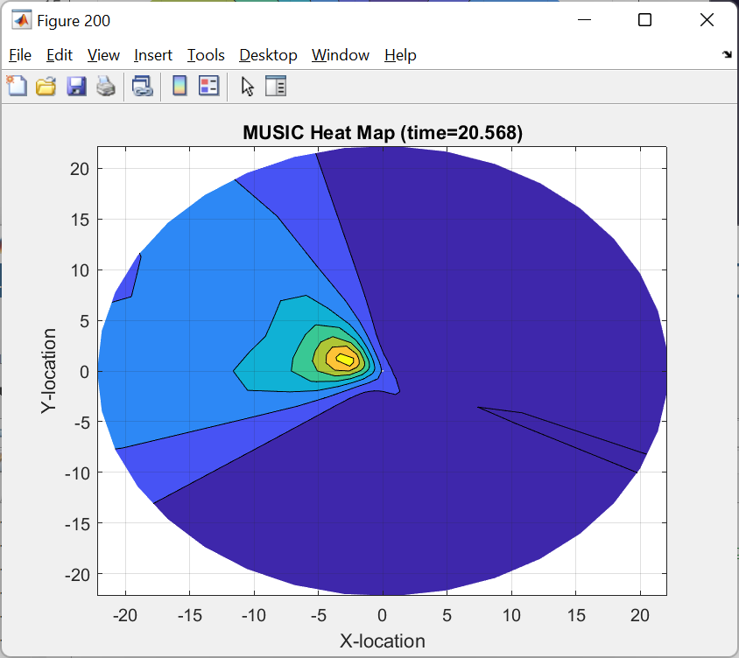
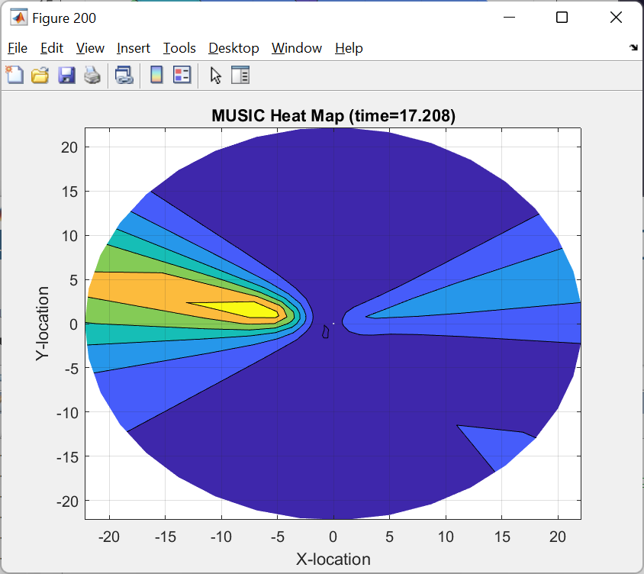
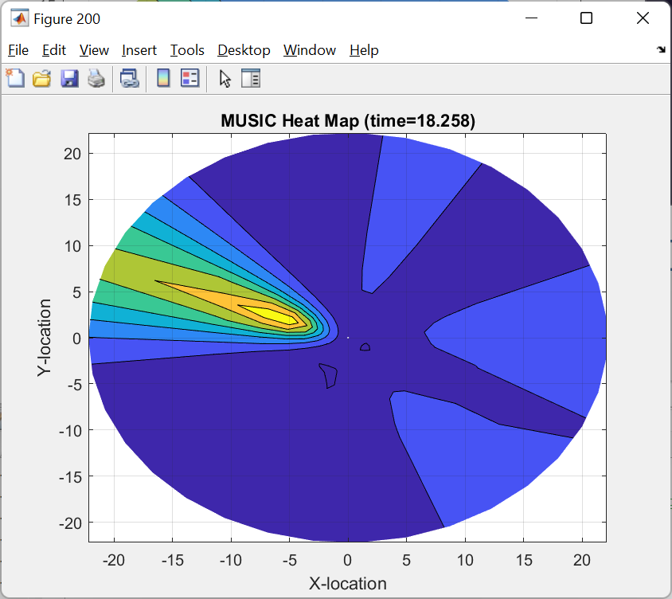
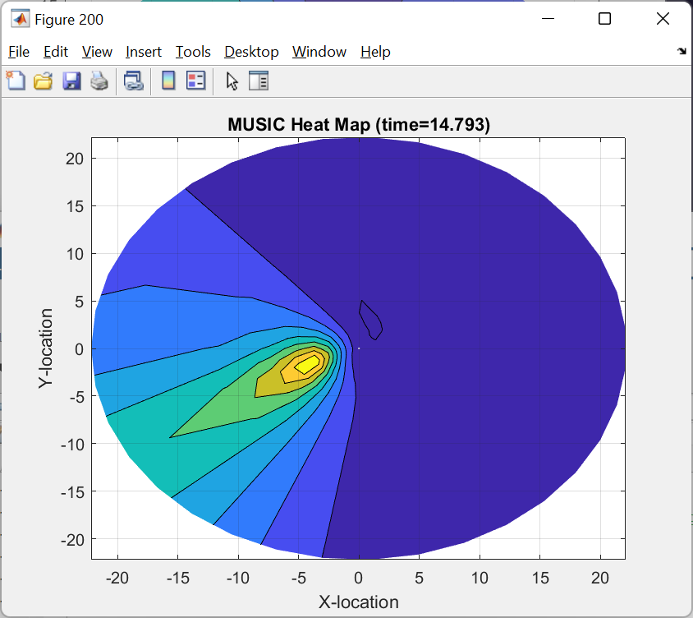
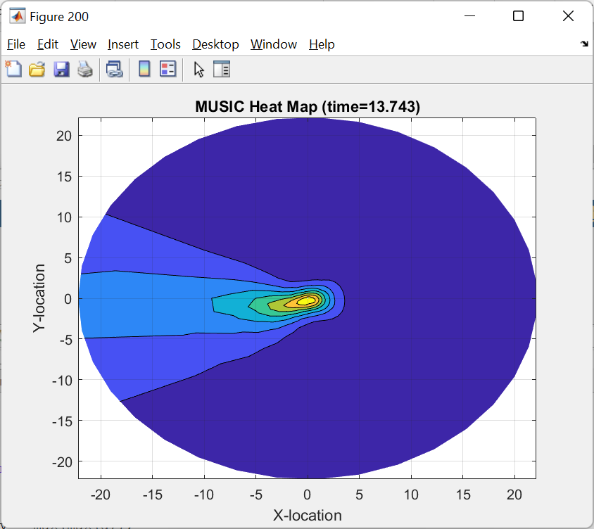
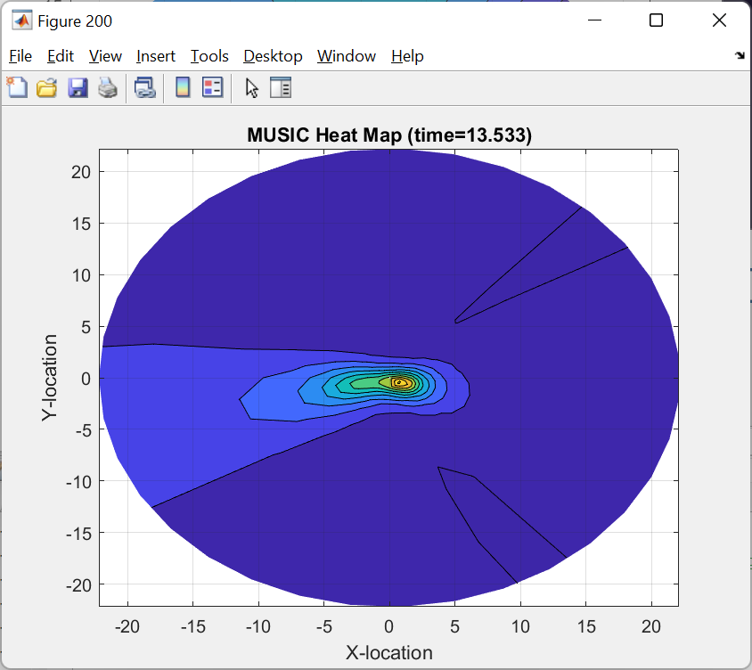
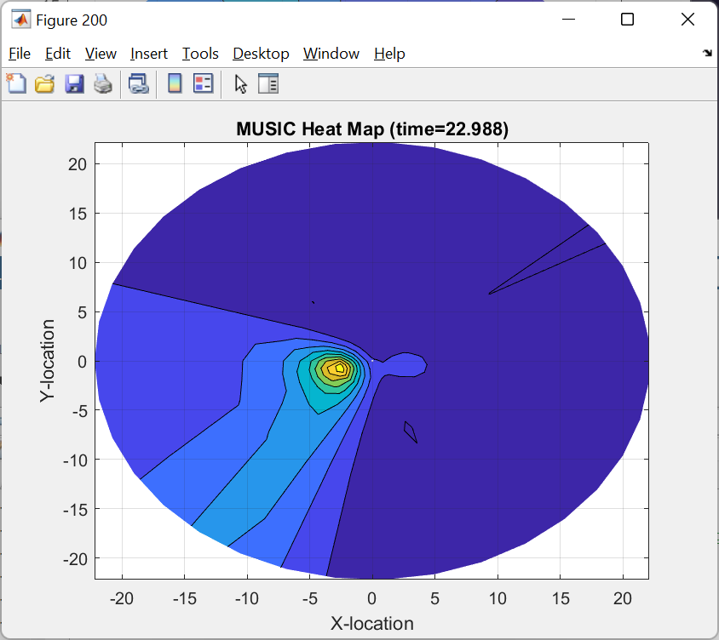
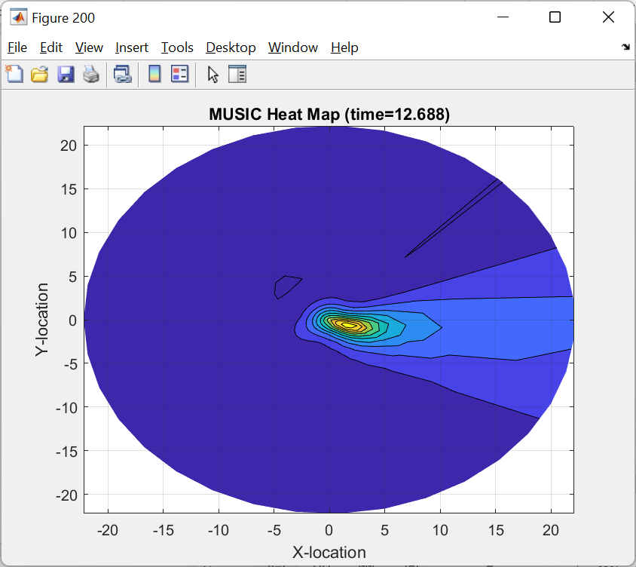
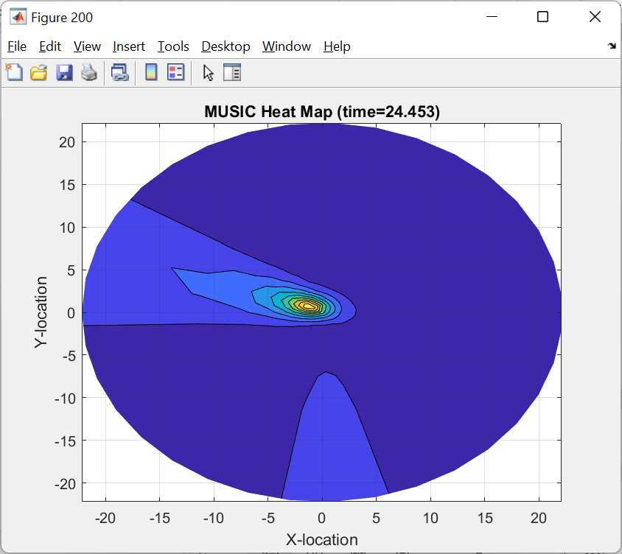

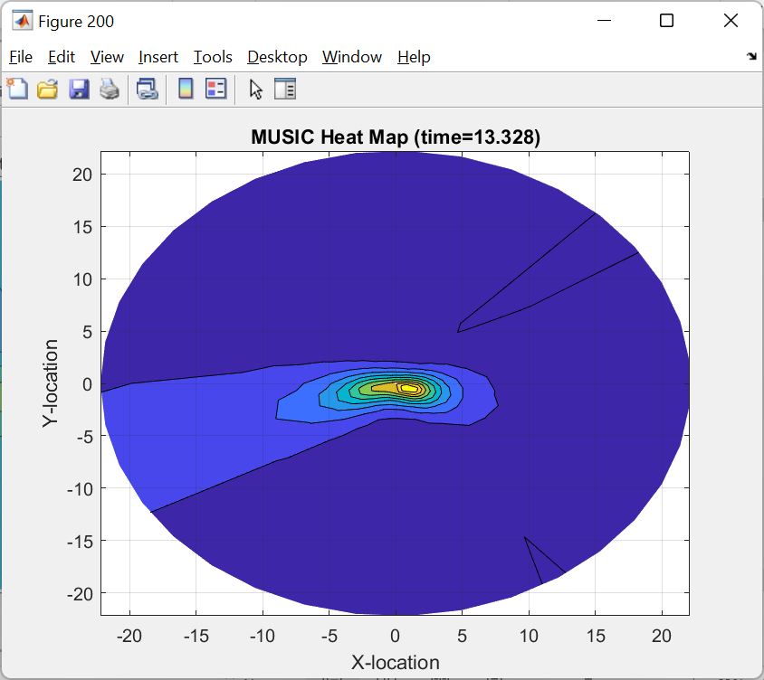
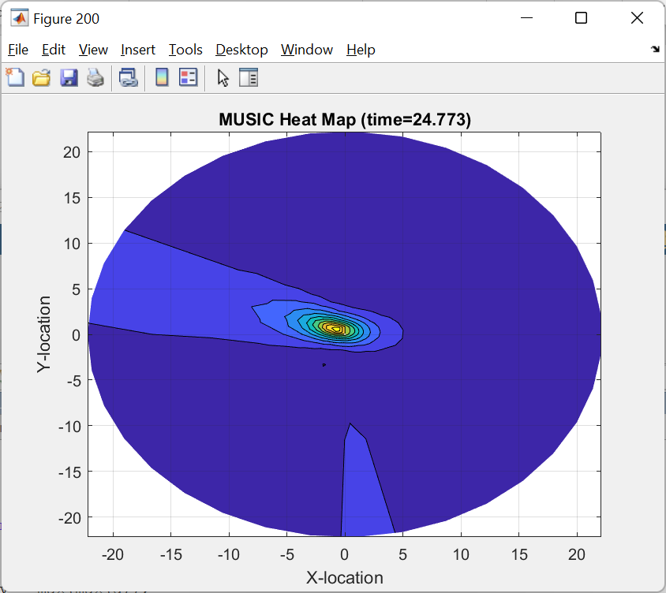
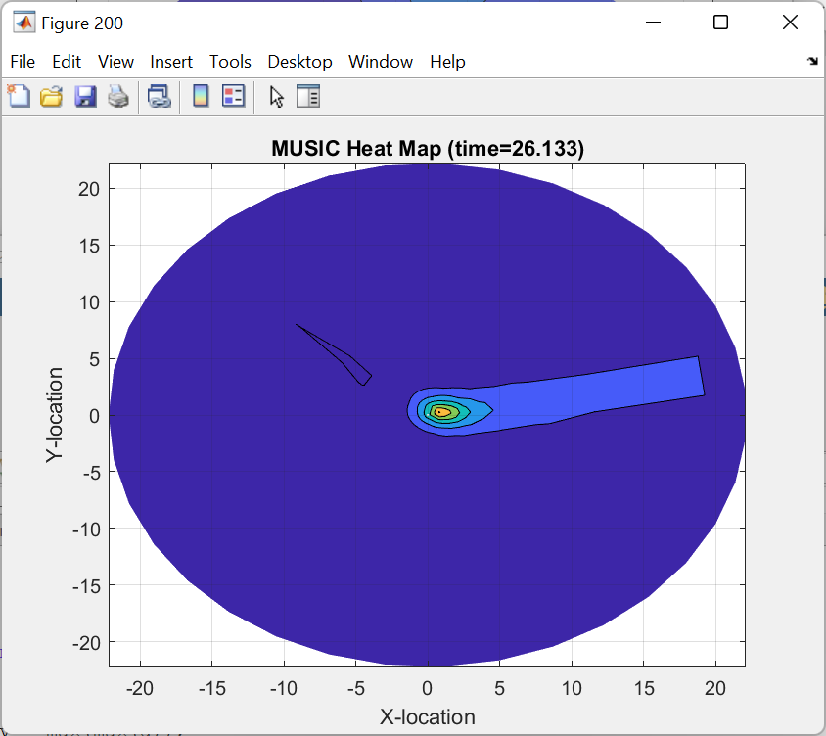
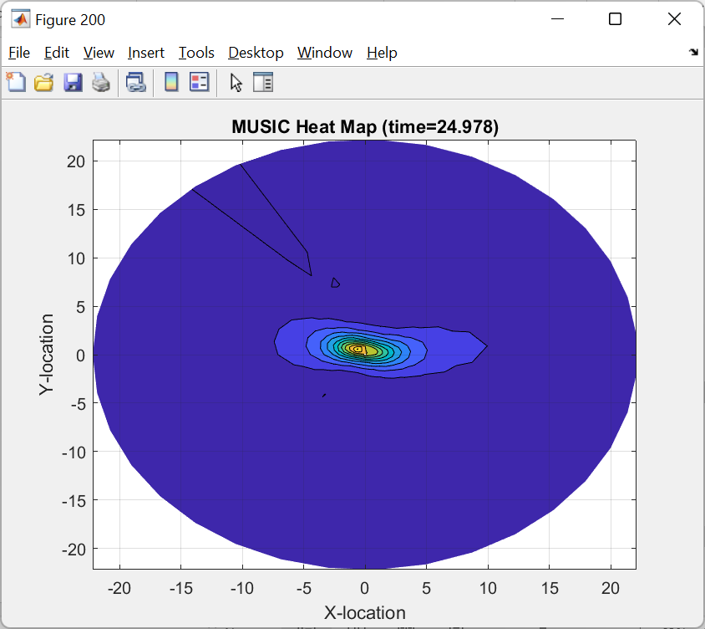
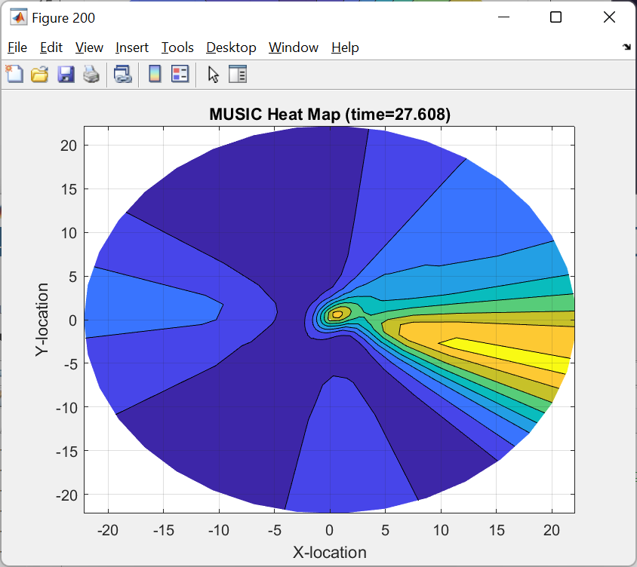
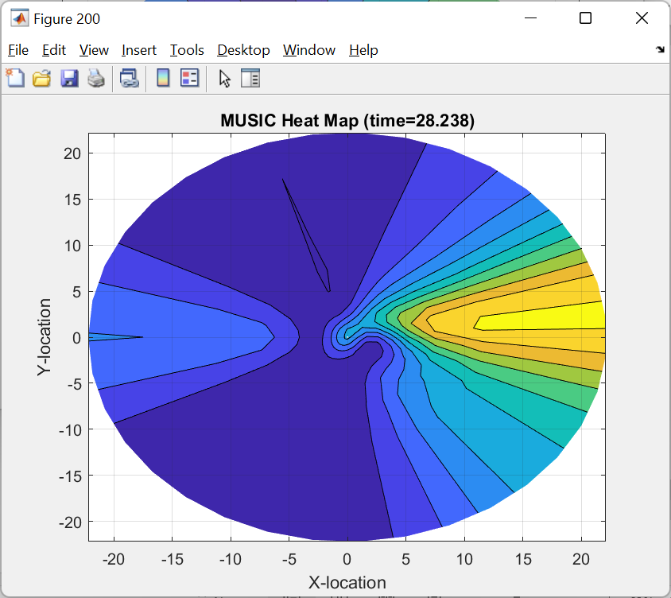



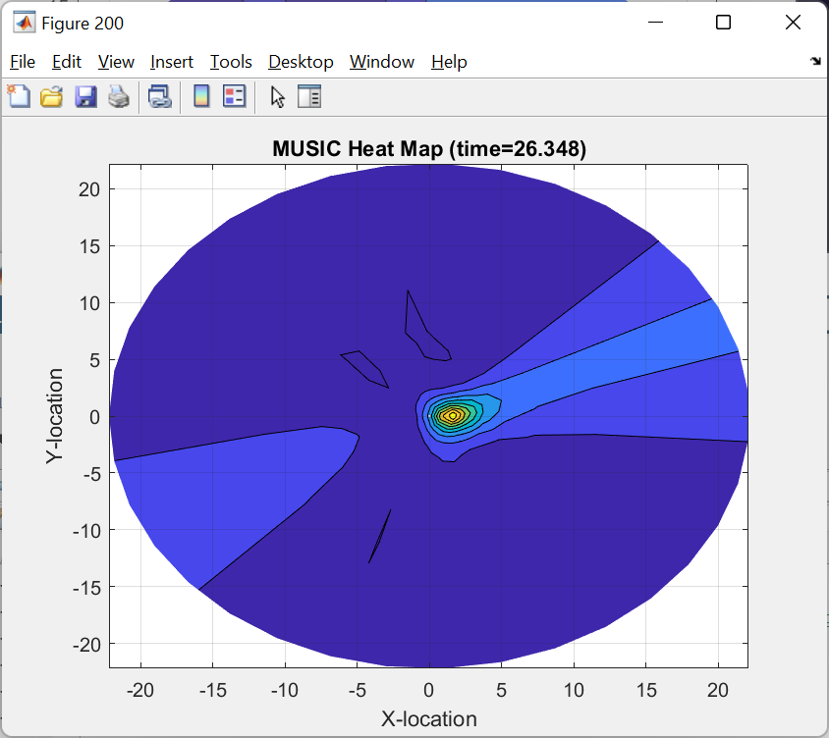
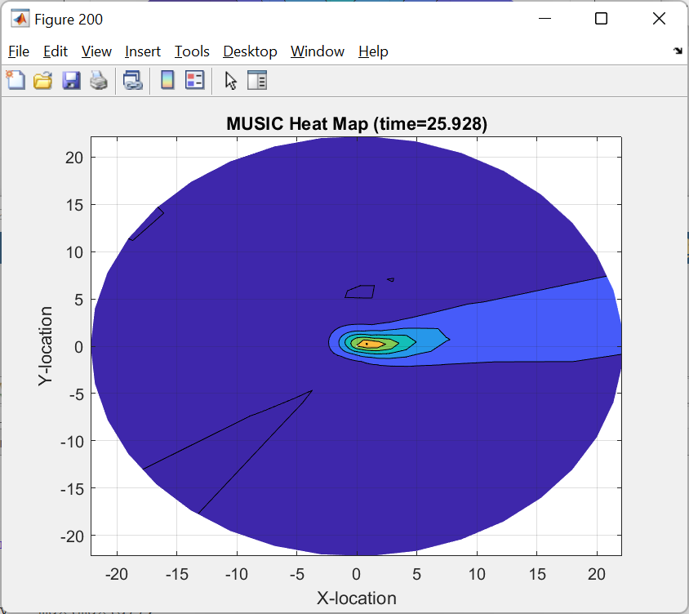
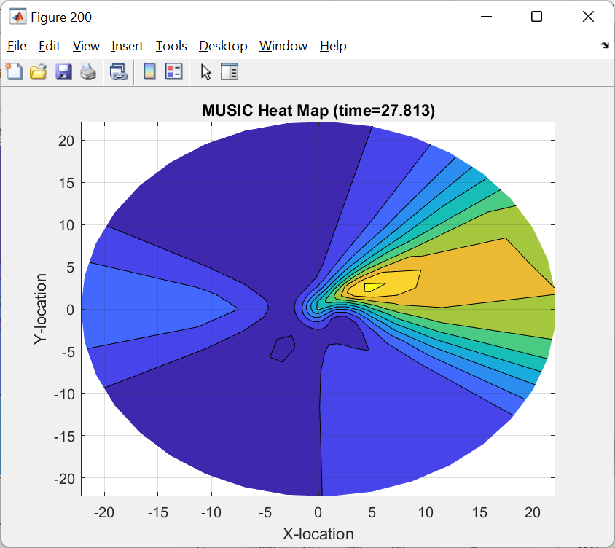
RadioVision “Heatmap Video” EXAMPLE
ROOM
Door
Emanate Wireless
Confidential and Proprietary

Slide 8
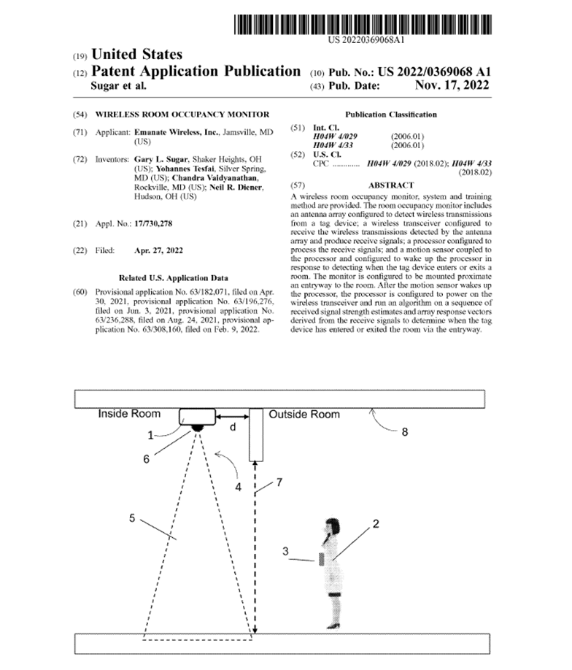
Novel and Highly Protected IP
Broad Patent Issued!
Priority Date: April 2021
20 PhD Person-years Invested in IP
$10M and 3+ Years to Replicate!
Funded to date via:
Angel $$
OEM Pilots
Government: NSF, PPP
Self Funding
Extensive Trade Secrets, including
ML Training/Test Data Set and Tools
DSP Algorithms
Domain Expertise, Arch Trade-offs
Hardware Specs: Antenna, PIR, Low-power

Slide 9


OEM Business Model Established
Model: Sell on OEM basis to leaders in RTLS
Analogy: We have world’s best fuel intake system, but don’t want to sell a car.
Avoids cost to develop expensive Apps, Marketing & Sales
Delivery Model:
RadioVision Monitor and Embedded SW as Finished Good
Recurring Revenue Model (SW License/Maintenance)
First OEM Order in Place
Well Funded and Aggressive New Entrant 1st Order = 5K Units
$1M Hardware, $100K Recurring Software License
Pipeline for Additional OEMs
Lab Pilots and Live Pilots

Slide 10

A VERY LARGE TAM
Healthcare (Traditional RTLS)
Hospitals = 3 Million Rooms
Skilled Nursing: 3 Million Rooms
Follow-On Markets:
Hospitality: Hotels = 9 Million Rooms
Enterprise: Carpeted Workspace = 15 Million Office Rooms
Modeled on $100 Hardware + $25 Annual Software License
TAM | Hardware CapEx | Software ARR
Healthcare | $600M | $150M
Hospitality | $900M | $225M
Enterprise | $1,500M | $375M
TOTAL | $3,000M | $750M

Slide 11
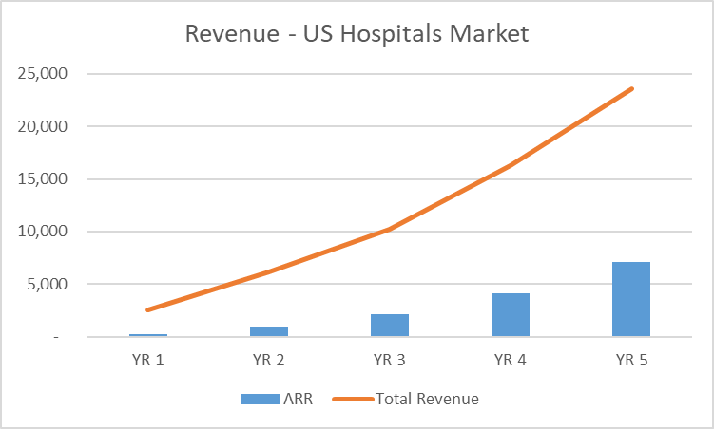
Strong Growth, With Recurring Component!
$100M+
Valuation
K$
Product Year
Total of 10% US Hospital Market Penetration by year 5
Does not include follow-on Markets
US Healthcare (Non-Hospital), ROW Healthcare
US Hospitality, US Enterprise, US Retail

Slide 12

Investment Opportunity
Raising $1M+ in 2H 2025
Angel Tranche (July 2025)
Strategic/Institutional (4Q 2025)
Use of Funds
Full Production by 2Q 2026
Fulfill First OEM Order for 5K Units
Spend
Hardware NRE
Team Funding for Production Software Development
OEM Sales and Support

Slide 13
BACKUP MATERIALS

Slide 14
July 2025 Angel Raise (Terms)
Pre-Money Valuation = $6M
Raise = Up to $1M
Royalty:
5% on RadioVision product Revenue
Paid Pro-Rata to July 2025 Investors
Until 1X is paid back

Slide 15
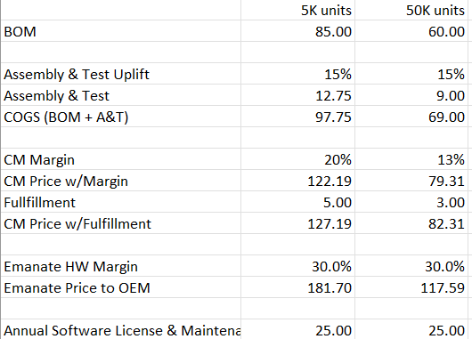
Production Hardware
Unit Economics
Hardware Design Partner – ACL Digital
Contract Manufacturer – Under Review
Schedule
October 2025: 1st Test Units (20)
January 2026: Beta Units (200)
April 2026: Production (5000+)

Slide 16
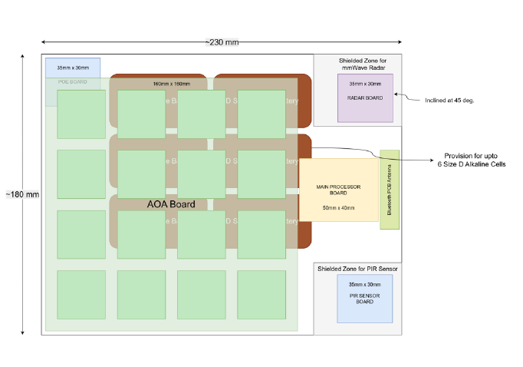
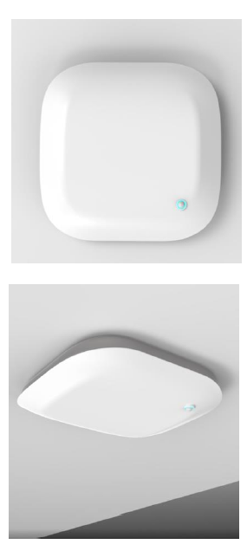
Production Unit – Industrial Design
Approximately 9” x 7”

Slide 17




Founding Team: Serial Entrepreneurs
Company | Acquirer | Product(s) | Team Role
2001-2007 | $60M 2007-2014 | Wi-Fi Interference Analysis Spectrum Expert CleanAir | Founders
1993-1998 | $50M 1998-2001 | Cellular Modems and Protocol Software ActiveAir V.60 Phones | Key Technical Principals

Slide 18
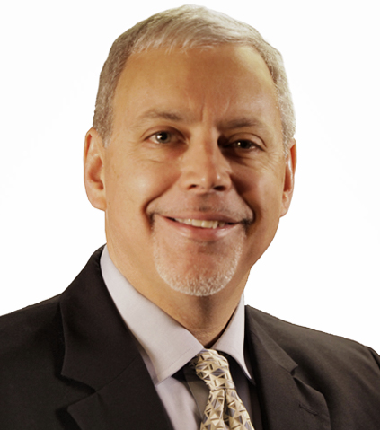
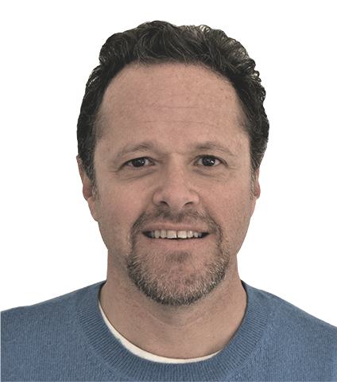
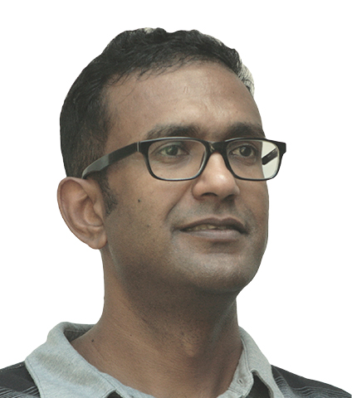
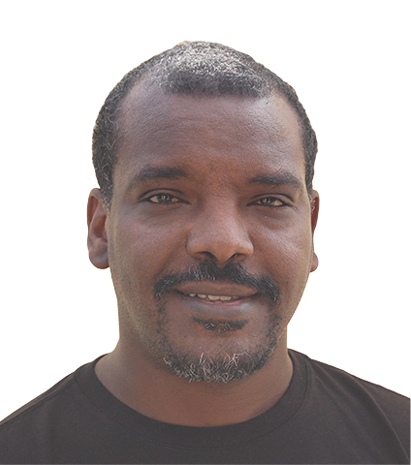
Founding Team: Deep Technical Background
Neil Diener – CEO
BSEE M.I.T / MSEE U.S.C
36 Patents
Embedded Software, Wireless Networks, AI, Operating Systems
Gary Sugar – CTO, VP Eng
BSEE / MSEE - University of Maryland
59 Patents
DSP, Wireless Systems, Machine Learning
Chandra V – Principal Eng
PhD EE – University of Minnesota
32 Patents
DSP, Antennas, Sensors, Algorithms
Yohannes T – Principal Eng
PhD EE – University of Virginia
16 Patents
DSP, Machine Learning, Error Correction
Core Expertise in Wireless, DSP, ML

Slide 19

Why RSSI-based BLE Room-Accuracy is HARD
RF goes through walls, and can be inadvertently directional, so it’s common to get the wrong room. < 80% Room Accuracy is Typical
Wrong
Room
Receiver 2
Receiver 1
Correct
Room
As much as 13 dB difference
in front-to-back signal strength
Side
View
Loss through wall is only 4-6 dB
(Low Attenuation)
Page ▪ 19
Page ▪ 19

Slide 20
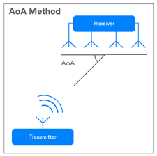
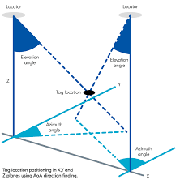
Wht AoA-based Room Accuracy is HARD
BLE 5.1 Added AoA (Angle of Arrival)
CTE Frame, Switch across array of antennas
“Standard” AoA deployment model is to sprinkle AoA receivers, and triangulate
ISSUE 1: Labor-intensive and difficult to get the locations/orientations of receivers and walls exactly correct. $1-2K Per Room Deployment $$ Typical
ISSUE 2: Even if solve #1, Using X,Y to get the right room requires 6” accuracy (one side of wall or another). < 90% Accuracy is Typical
Others (ex. Cisco HALO) have spent $Millions and FAILED with this approach!
Discontinued in the market

Slide 21
Competition - OEM BLE AoA Tech Vendors
Feature | Emanate | Minew | U-Blox | Quuppa | ioSEA
Doorway Chokepoint | Yes | No | No | No | No
Completeness of Solution | Finished solution with complete hardware/ software | Reference box and software | SDK: Antenna Board and sample software | SDK: Antenna Board and sample software | SDK: Antenna Board and sample software
99% Accuracy (ML) | Yes | No | No | No | No
Battery Powered | Yes | No | No | No | No
Low Cost Install | Yes | No | No | No | No

Slide 22












PowerPath Temp Deployments
Additional Hospitals/Medical
Fisher Titus Hospital
Columbus Regional Hospital
Cleveland MedCare Centers
Apex Dermatological
Surgery Centers Central Florida
The Cardiac and Vascular Institute
Winter Garden Surgery Center
Individual Physician Offices
Medical Research
Case Western
U. Pennsylvania
Commercial
Atex Technologies
Dairy Free
Main Campus
Cancer Center
Pediatrics (R-Building) & Children’s Hospital
Main Campus Kitchens
Main Campus OR
Main Campus Point of Care Testing
Neurological Institute
Receiving – Pharmacy and Main
Cleveland Area Regional
All Regional Oncology Centers
All Outpatient Pharmacies
FHC Point of Care Testing
Avon Hospital
Marymount Hospital and ASC
Fairview Hospital
Hillcrest Hospital and Medical Center
Florida
Weston Hospital
Coral Springs Medical Center
FHC: WPB, PBG, Wellington

